Slide 1
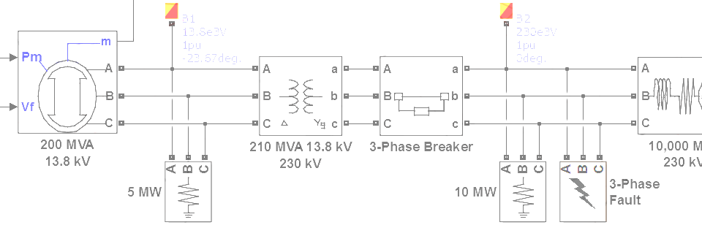

SimPowerSystems Hands-on Workshop: Modeling and Simulation of Electrical Power Systems with SimPowerSystemsTM
7. Power Electronics
Carlos Osorio
Principal Application Engineer
MathWorks – Natick, MA

Slide 2
Outline
SimElectronics or SimPowerSystems?
Ideal switching algorithm
Power quality and harmonic analysis
Control design and linearization

Slide 3
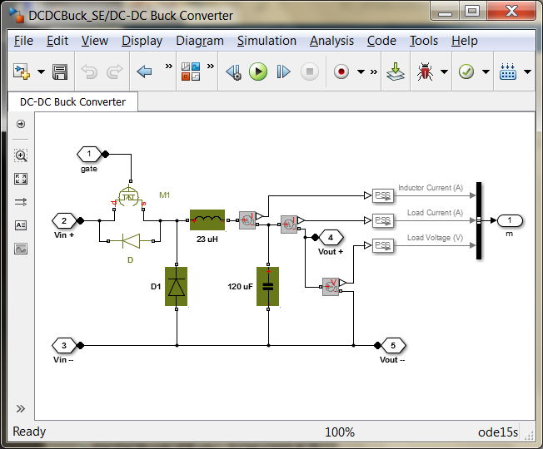
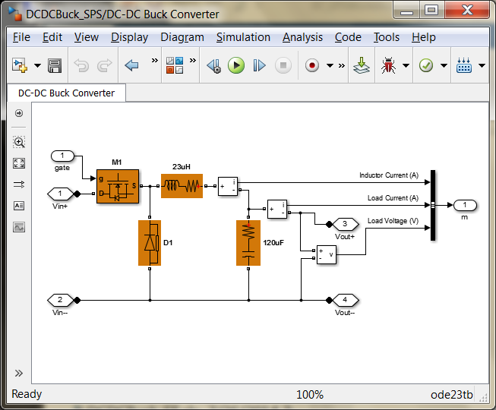
SimElectronics or SimPowerSystems?
SimPowerSystems
Piecewise linear systems solution
Multiphase bridges and pulse generators
Detailed and average voltage models
Transient and harmonic analysis
Faster simulation
SimElectronics
Simultaneous nonlinear equations solution
SPICE level switching device models
Include switching losses
Include parasitic current effects
Include temperature effects
Higher fidelity simulation
>> se_dcdcbuckconverter
>> sps_dcdcbuckconverter

Slide 4
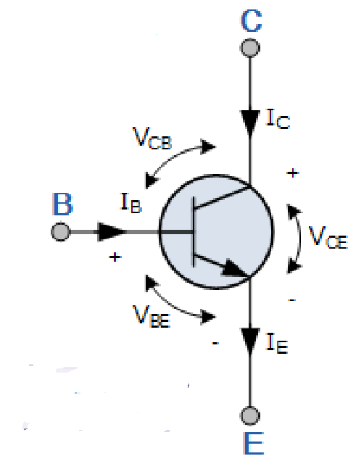
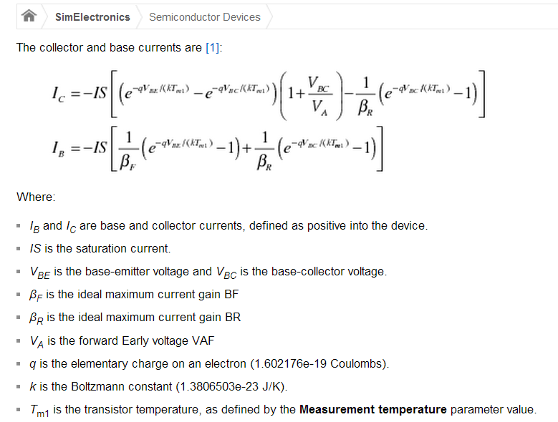
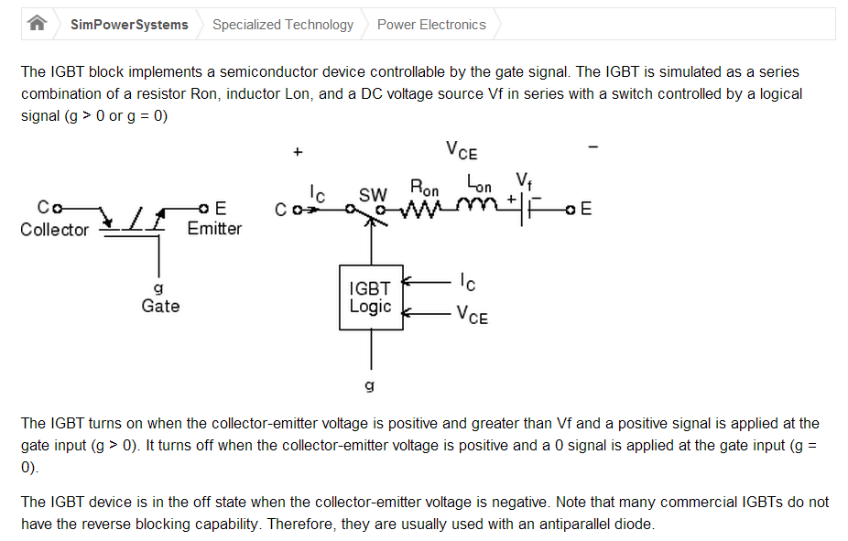


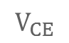
SimElectronics or SimPowerSystems?
SimElectronics
SimPowerSystems
$$V_{BE}$$
$$I_{CE}$$
$$V_{CE}$$

Slide 5
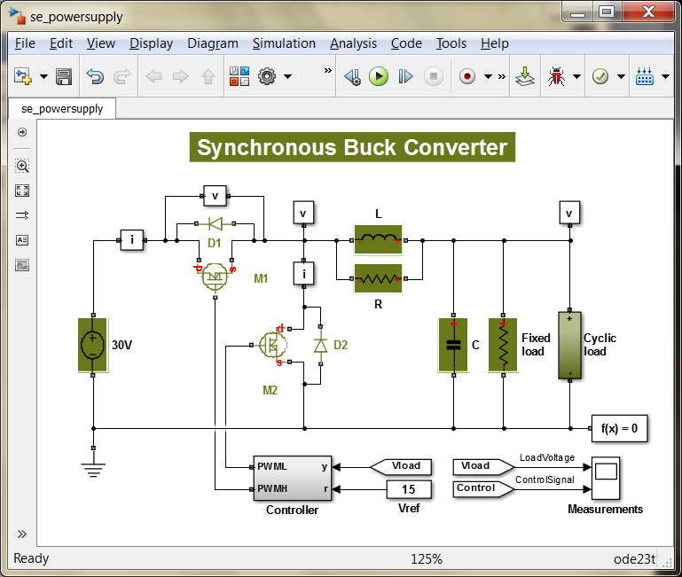
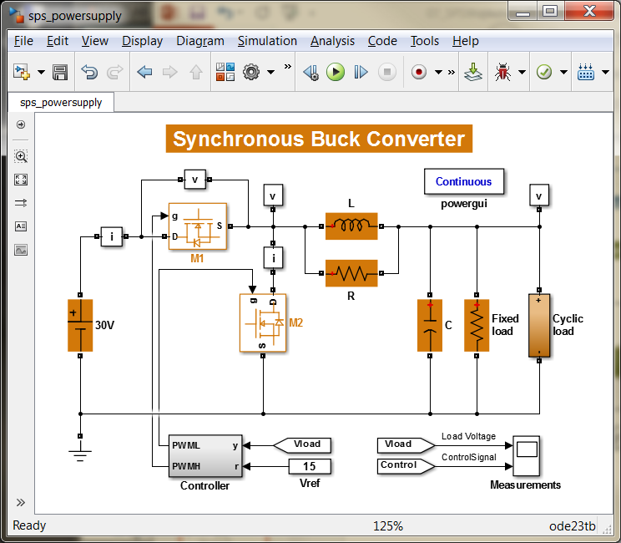
SimElectronics or SimPowerSystems?
SimElectronics
SimPowerSystems
>> edit compare_powersupply

Slide 6
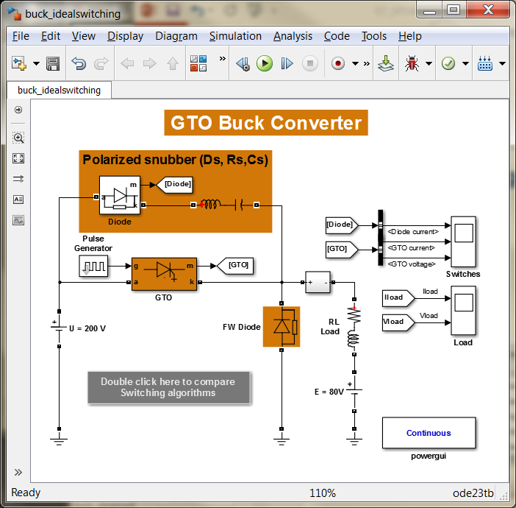
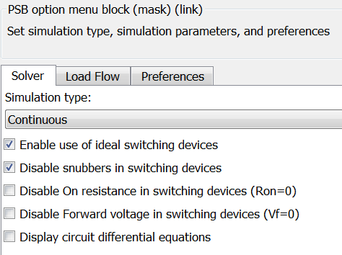
Ideal switching algorithm
The ideal switching method can be selected from the solver configuration parameters tab when in Continuous simulation mode
>> edit compare_idealswitching

Slide 7
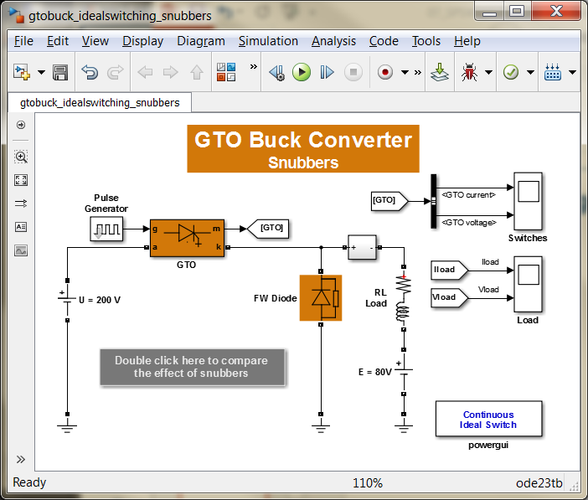
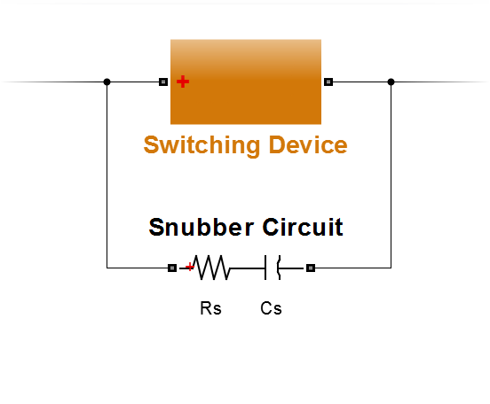
Ideal switching algorithm Effect of using snubber circuits
Snubbers provide an alternate path for discharging inductive elements and protecting switching devices in high power systems
>> edit compare_snubbers

Slide 8
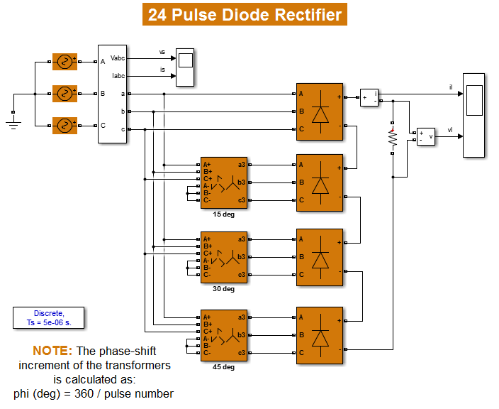
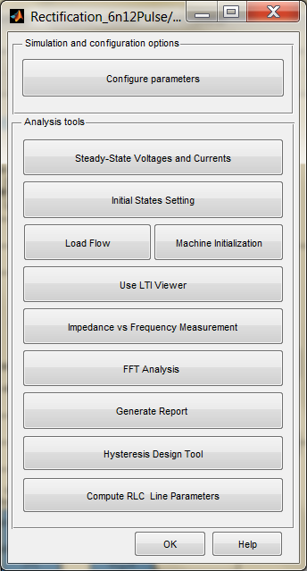
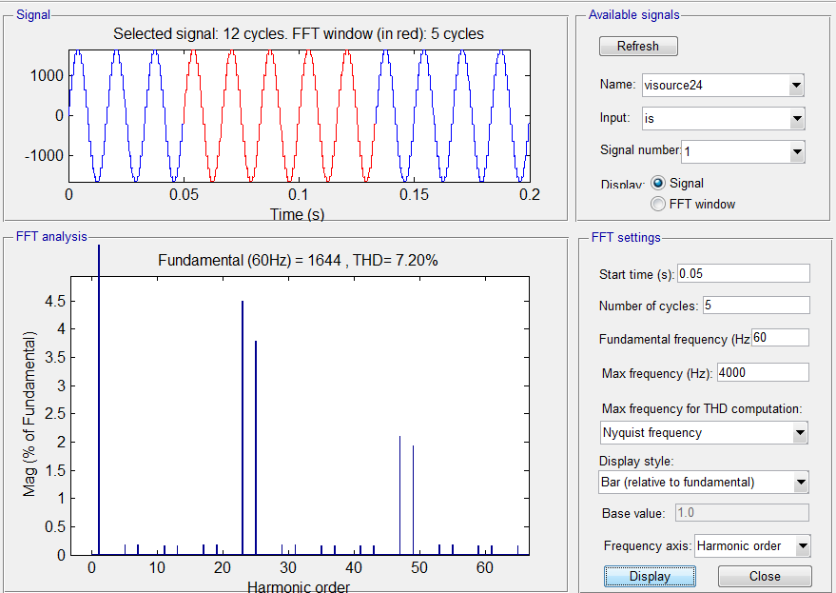
Power quality and harmonic analysis Multi-pulse rectification
powergui
>> rectifier_6n12pulse
>> rectifier_24pulse

Slide 9
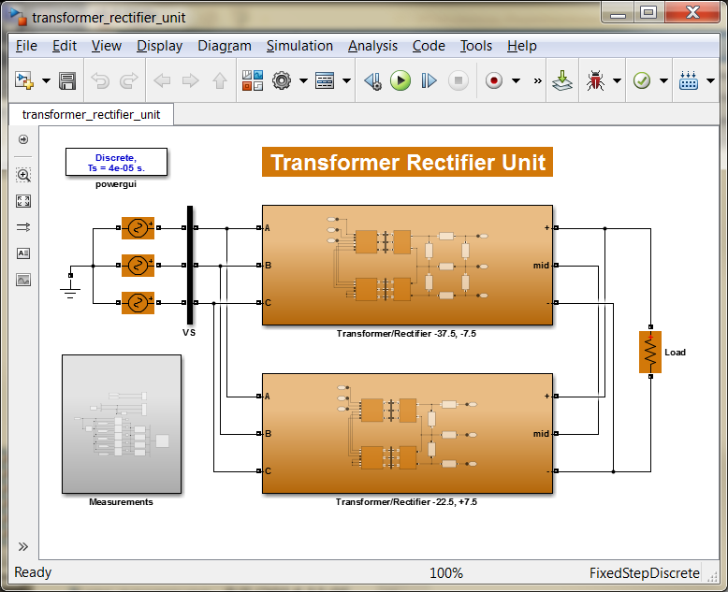
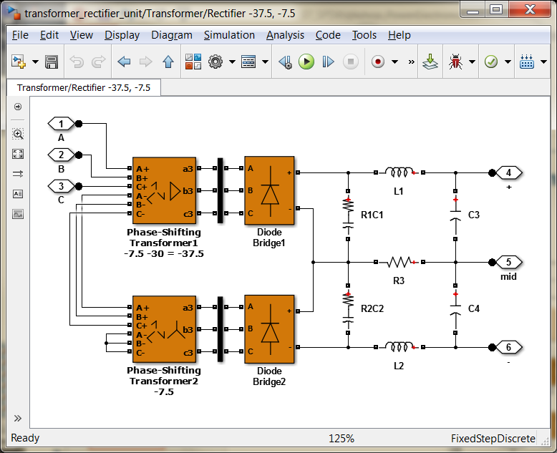
Power quality and harmonic analysis Transformer rectifier units (TRUs)
>> transformer_rectifier_unit

Slide 10
Power quality and harmonic analysis Switching strategies – Pulse-Width Modulation (PWM)
The aim of PWM is to construct a high frequency carrier wave which contains an underlying, lower frequency modulation wave
The modulation wave is the waveform that you want the electrical system to ‘see’
Higher order harmonics will depend on the ratio of the carrier wave frequency and the modulation wave frequency
carrier wave
modulation wave
PWM Duty Cycle
for full amplitude modulation
PWM Duty Cycle
for 50% amplitude modulation

Slide 11
Power quality and harmonic analysis Switching strategies – Pulse-Width Modulation (PWM)
A_{pwm}
B_{pwm}
C_{pwm}

Slide 12
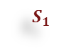
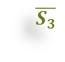
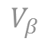


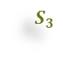
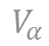


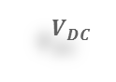
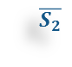


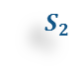


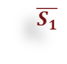

Power quality and harmonic analysis Switching strategies – Space Vector Modulation (SVM)
The aim of SVM is to approximate the reference voltage vector instantaneously by combining the switching states corresponding to eight basic vectors
$$V_{β}$$
$$+$$
$$S_{1}$$
$$S_{2}$$
$$S_{3}$$
$$V_{b}$$
$$V_{DC}$$
A
B
C
3
2
$$\overline{S_{1}}$$
$$\overline{S_{2}}$$
$$\overline{S_{3}}$$
$$V$$
4
$$ωt$$
1
0
$$V_{α}$$
0
1
2
3
4
5
6
7
,7
$$V_{a}$$
$$S_{1}$$
0
1
1
0
0
0
1
1
$$S_{2}$$
0
0
1
1
1
0
0
1
5
6
$$V_{c}$$
$$S_{3}$$
0
0
0
0
1
1
1
1
Notes:
Space vector modulation (SVM) is to approximate the reference voltage vector ($\overline{v}$) instantaneously by combining the switching states corresponding to the basic space vectors.
There are totally 8 space vectors corresponding to 8 different switching state combinations. The equation to get the voltage vector from 3-phase voltages is given by
$\overline{v}=\frac{2}{3}∙\left(v_{A}+{a∙v}_{B}+a^{2}∙v_{C}\right)$, where $a=e^{j{120}^{°}}$
For every PWM period (switching period), the reference voltage vector $\overline{v}$ is averaged by using its two adjacent space vectors ( e.g., Vector 1 and Vector 2 in the figure) for a certain duration of time and zero vectors (Vector 7 and Vector 8) for the rest of the period.
The advantage of SVM is that it has better utilization of DC-link voltage than that of SPWM.
1). For the same application, the DC-link voltage for SVM is lower than that for SPWM, then the IGBT devices with lower voltage ratings can be selected. Also the switching loss is lower than that of SPWM.
2). For the same DC-link voltage, the max. output fundament voltage by using SVM is higher than that of SPWM.
Exercise: Use SVM to control the 3-phase full-bridge inverter.
This example is also related to the model 'InductionMachineStartup.slx' in Chapter 2.
Open ‘IGBT_inv_3_svm_qd.slx’
Figure out how much DC-link voltage is large enough to generate the required output 3-phase voltages if SVM is used. In the model 'InductionMachineStartup.slx', the max. required fundamental voltage (phase-to-neutral, peak) is 377 V.
Complete the missing part in the model to get the modulation signals. A reference frame transformation block is necessary.
Solution file:
IGBT_inv_3_svm_qd_sln.slx

Slide 13
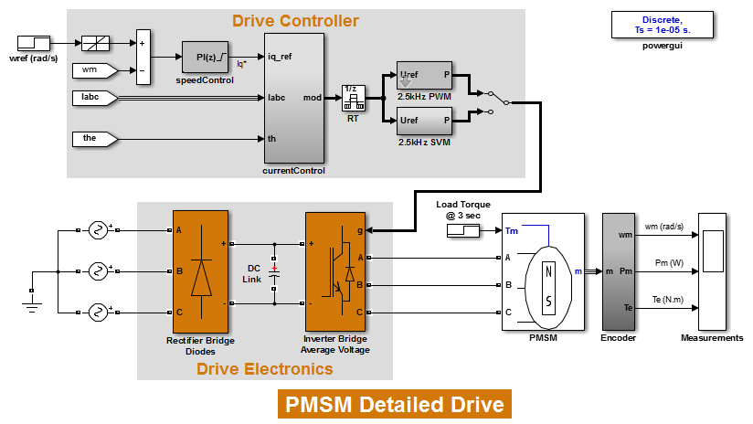
Power quality and harmonic analysis Comparing switching strategies
Outer loop: speed control
Inner loop: current/torque control
>> pmsm_detailed_drive

Slide 14
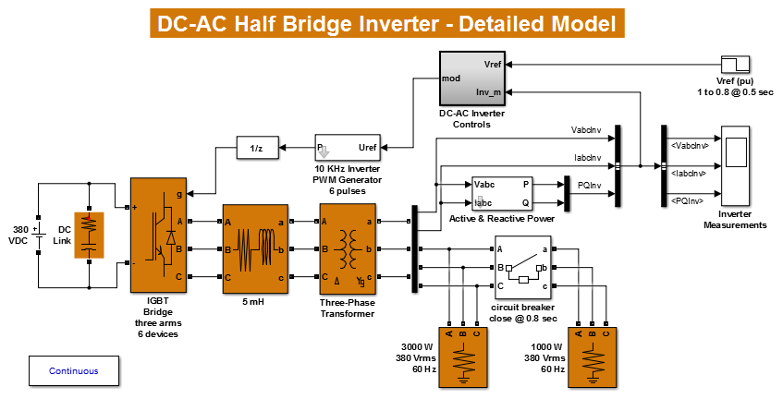
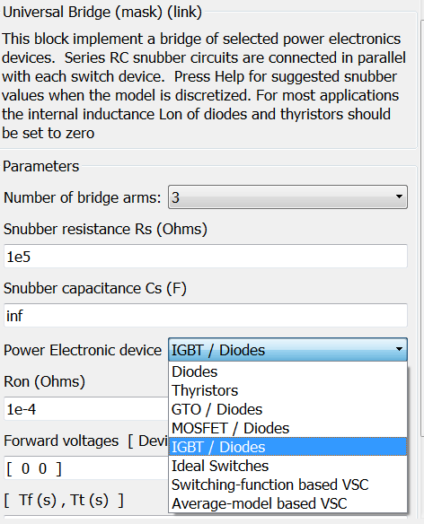
Control design and linearization Detailed and average transistor bridges
Switch the inverter bridge to an average voltage model and comment through the PWM signal generator
1
>> igbt_power_inverter_det

Slide 15
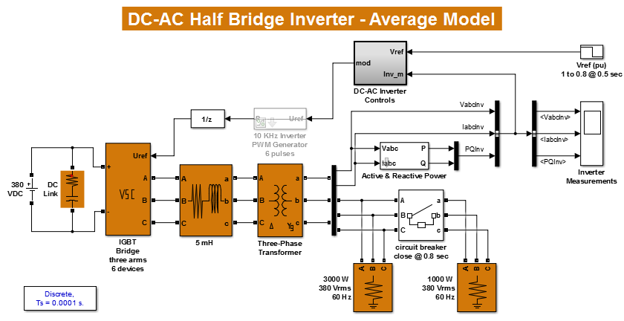
Control design and linearization Detailed and average transistor bridges
2
Adjust the simulation mode and sampling rates appropriately
Notice that the controller runs at a 10 kHz rate
>> igbt_power_inverter_avg

Slide 16
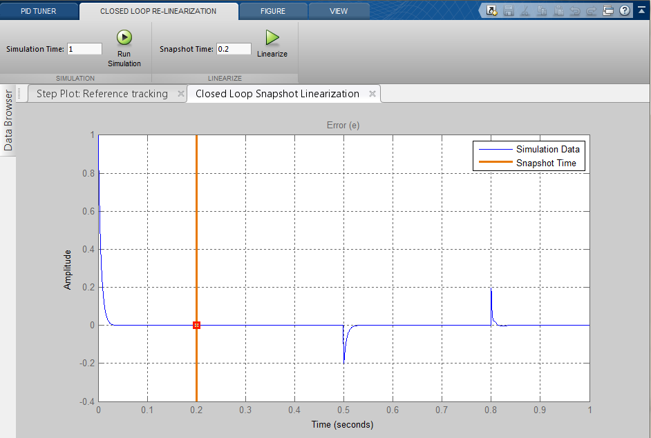
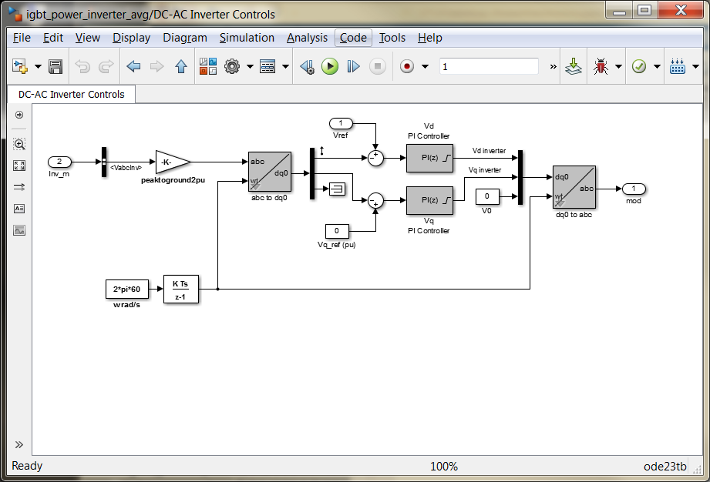
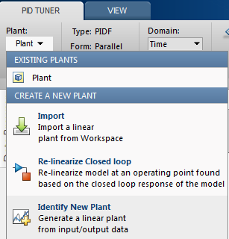
Control design and linearization Detailed and average transistor bridges
3
Open the PID tuner app from the V_{d} controller and re-linearize the closed loop based on the model at a simulation snapshot of 0.2 seconds
>> igbt_power_inverter_avg

Slide 17
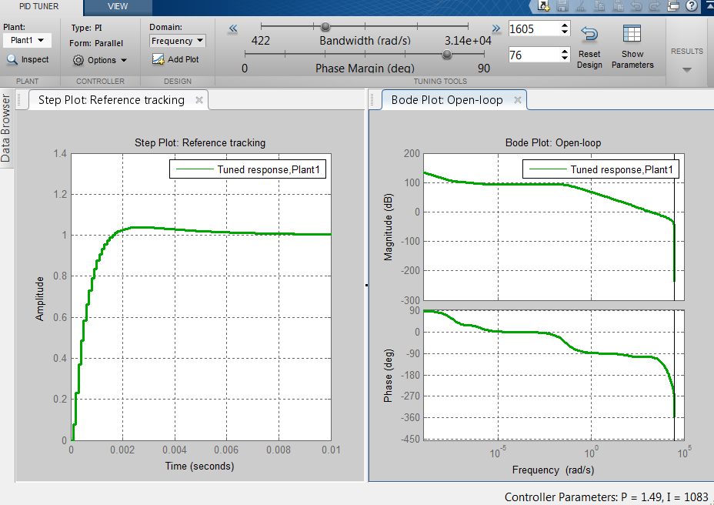
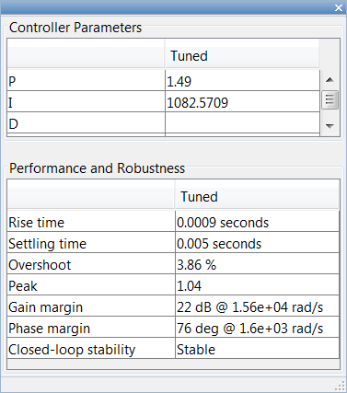
Control design and linearization Detailed and average transistor bridges
4
Use the sliders in the app to tune the V_{d} controller for the following performance targets:
bandwidth > 200 Hz
settling time < 5 milliseconds
overshoot < 5%
>> igbt_power_inverter_avg

Slide 18
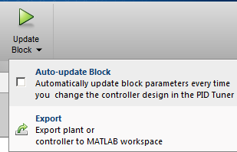
Control design and linearization Detailed and average transistor bridges
5
Click Update Block and verify the performance of the controller against the detailed switching inverter model in simulation
For simplicity, we will use the same newly computed PI gains for the V_{q} controller
>> igbt_power_inverter_avg

Slide 19
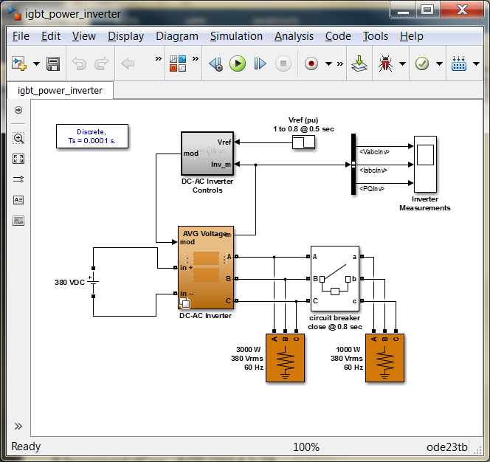
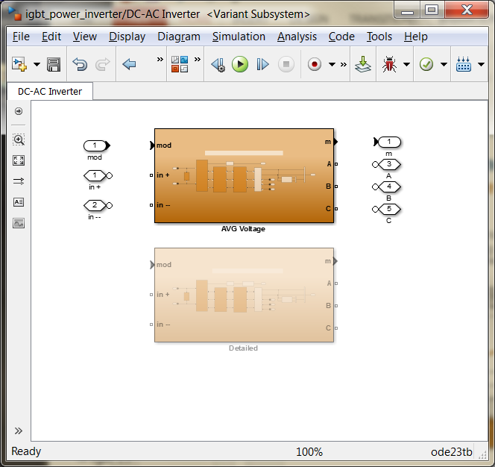
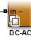
Control design and linearization Detailed and average transistor bridges
6
Combine both versions of the inverter in a single model using a Variant Subsystem
Subsystem & Model Reference → Convert Subsystem to…
>> igbt_power_inverter

Slide 20
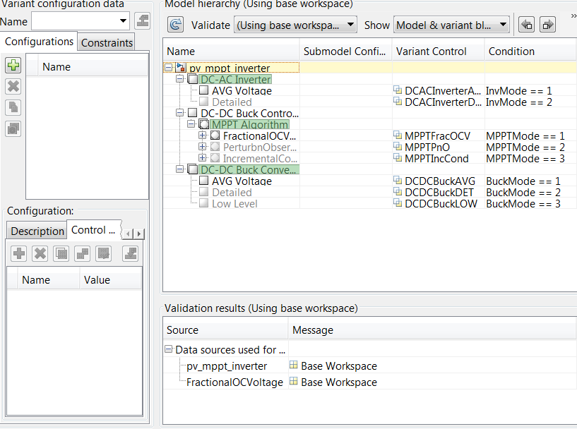
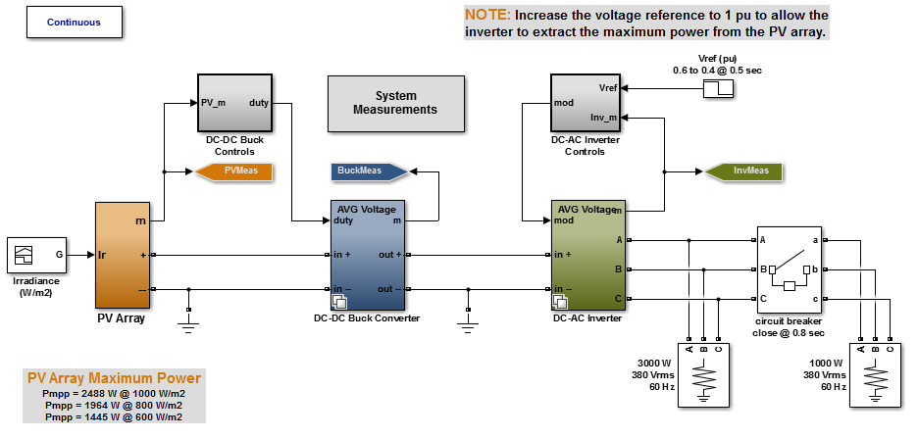
Control design and linearization Using subsystem variants
Use the Variant Manager to set multiple variant configurations for simulation and testing
Variant → Open in Variant Manager
>> pv_mppt_inverter

Slide 21
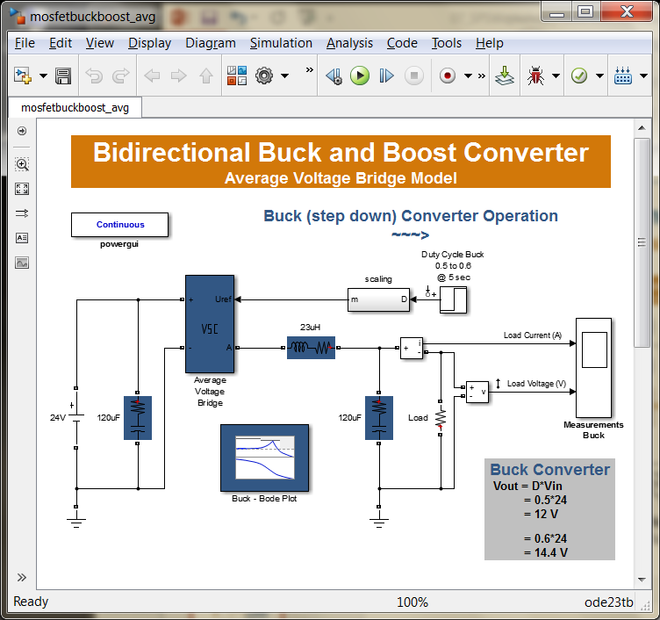
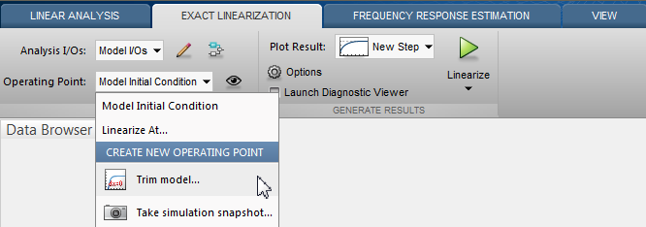
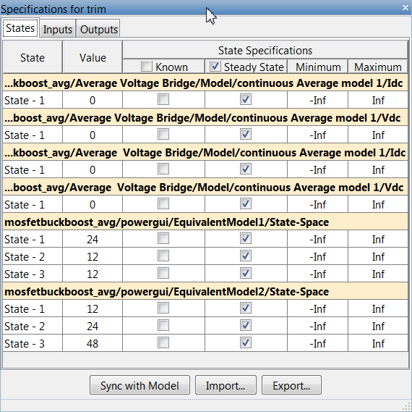
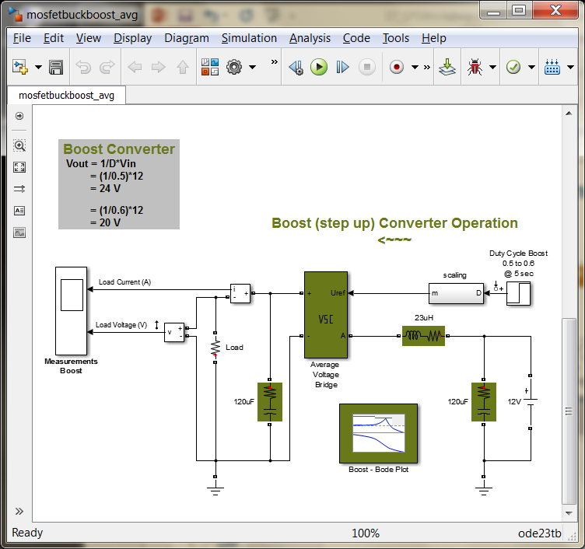
Control design and linearization Initialization and trimming
1
Use the Trim model option in the Linear Analysis tool
Analysis → Control Design → Linear Analysis…
2
Check the Specifications for the output voltages as known and trim the model
Change optimization method to nonlinear least squares
>> mosfetbuckboost_avg

Slide 22
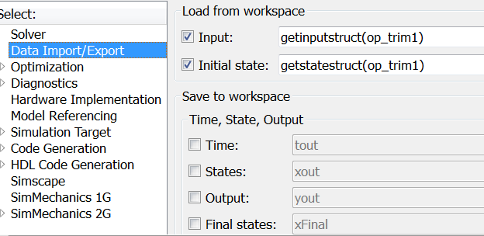
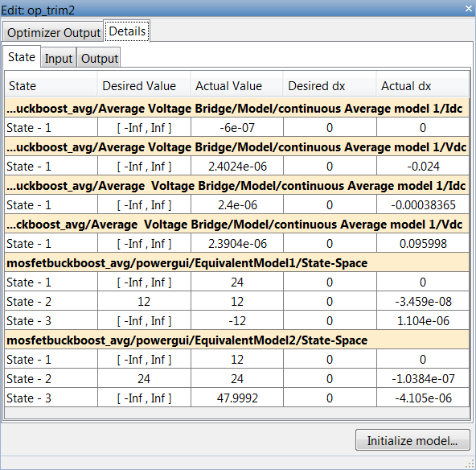
Control design and linearization Initialization and trimming
3
Verify trimmed operating condition and initialize model
4
Run simulation with the computed operating condition object as initial states
>> mosfetbuckboost_avg

Slide 23
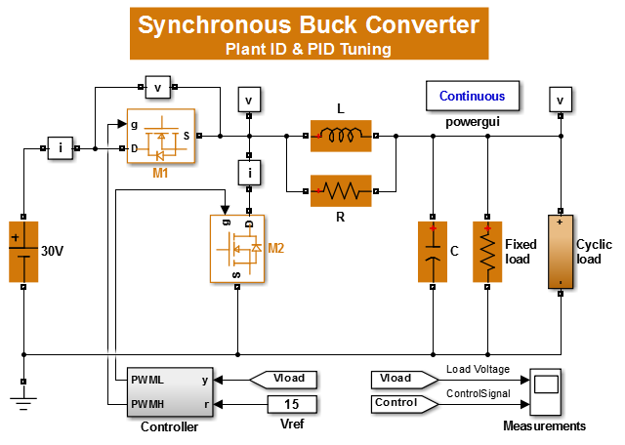
Control design and linearization Plant identification from simulation data
1
Use the Identify New Plant option in the PID tuner
>> sps_powersupply_sid

Slide 24
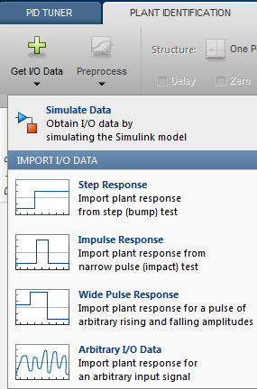

Control design and linearization Plant identification from simulation data
3
Set up a Step Response test with the following characteristics:
Sample Time = 5e-6
Offset = 0.5
Onset Lag = 0.003
Amplitude = 0.4
2
Choose Simulate Data to obtain I/O results from the simulation model
>> sps_powersupply_sid

Slide 25


Control design and linearization Plant identification from simulation data
4
Run the simulation to obtain the identification data
Select the model structure and use the interactive handles to match the model to the data
5
>> sps_powersupply_sid

Slide 26

Control design and linearization Frequency response estimation
1
Open the Frequency Response Estimation tool
Analysis → Control Design → Frequency…
2
Create a new input Fixed Sample Time Sinestream with T_{s} = 1e-7
Use the pre-computed analytic transfer function of the converter GDBuck as a reference for selecting the test frequencies and increase the amplitude of the test sine waves to 1e-1
>> mosfetbuck_fre

Slide 27


Control design and linearization Frequency response estimation
3
Check the Diagnostic Viewer option and run the estimation
>> mosfetbuck_fre

Slide 28


Control design and linearization Multi-input, multi-output control tuning
1
From the model, open the Control System Tuner application
Analysis → Control Design → Control System Tuner…
>> speedcontrol_dcmotor

Slide 29



Control design and linearization Multi-input, multi-output control tuning
2
In the Control System tab, capture a new operating point by taking a simulation snapshot at 10 seconds
4
In the Tuning tab, select the two new desired tuning goals
Goal #1: Desired step response
Input: speed reference
Output: speed measurement
Time constant = 0.05 seconds
Goal #2: Target shape for open loop response
Response at current measurement
Open loop at the speed measurement
Crossover frequency = 100*2*pi rad/s
3
In the Tuning tab, select the controller blocks to be tuned
>> speedcontrol_dcmotor

Slide 30

Control design and linearization Multi-input, multi-output control tuning
5
Tune the system and check that both requirements are being adequately satisfied after the optimization
6
In the Control System tab, select Update Blocks and verify the performance of the controller against the nonlinear model in simulation
>> speedcontrol_dcmotor

